Slide 1

Notes:
Eniac

Slide 2


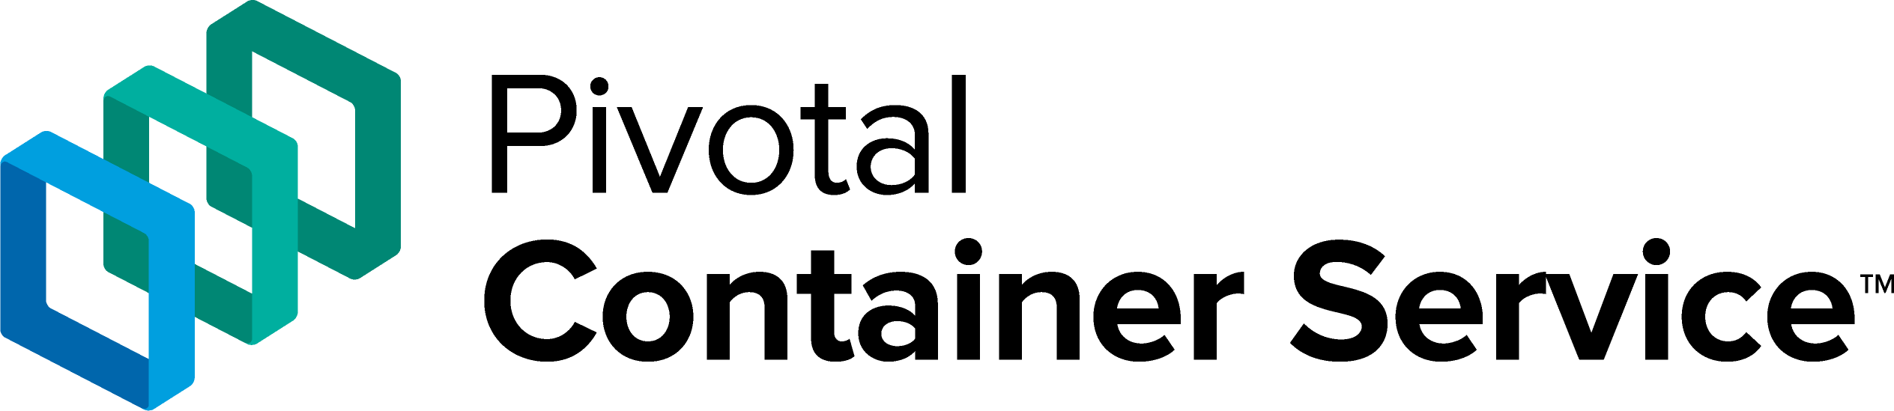
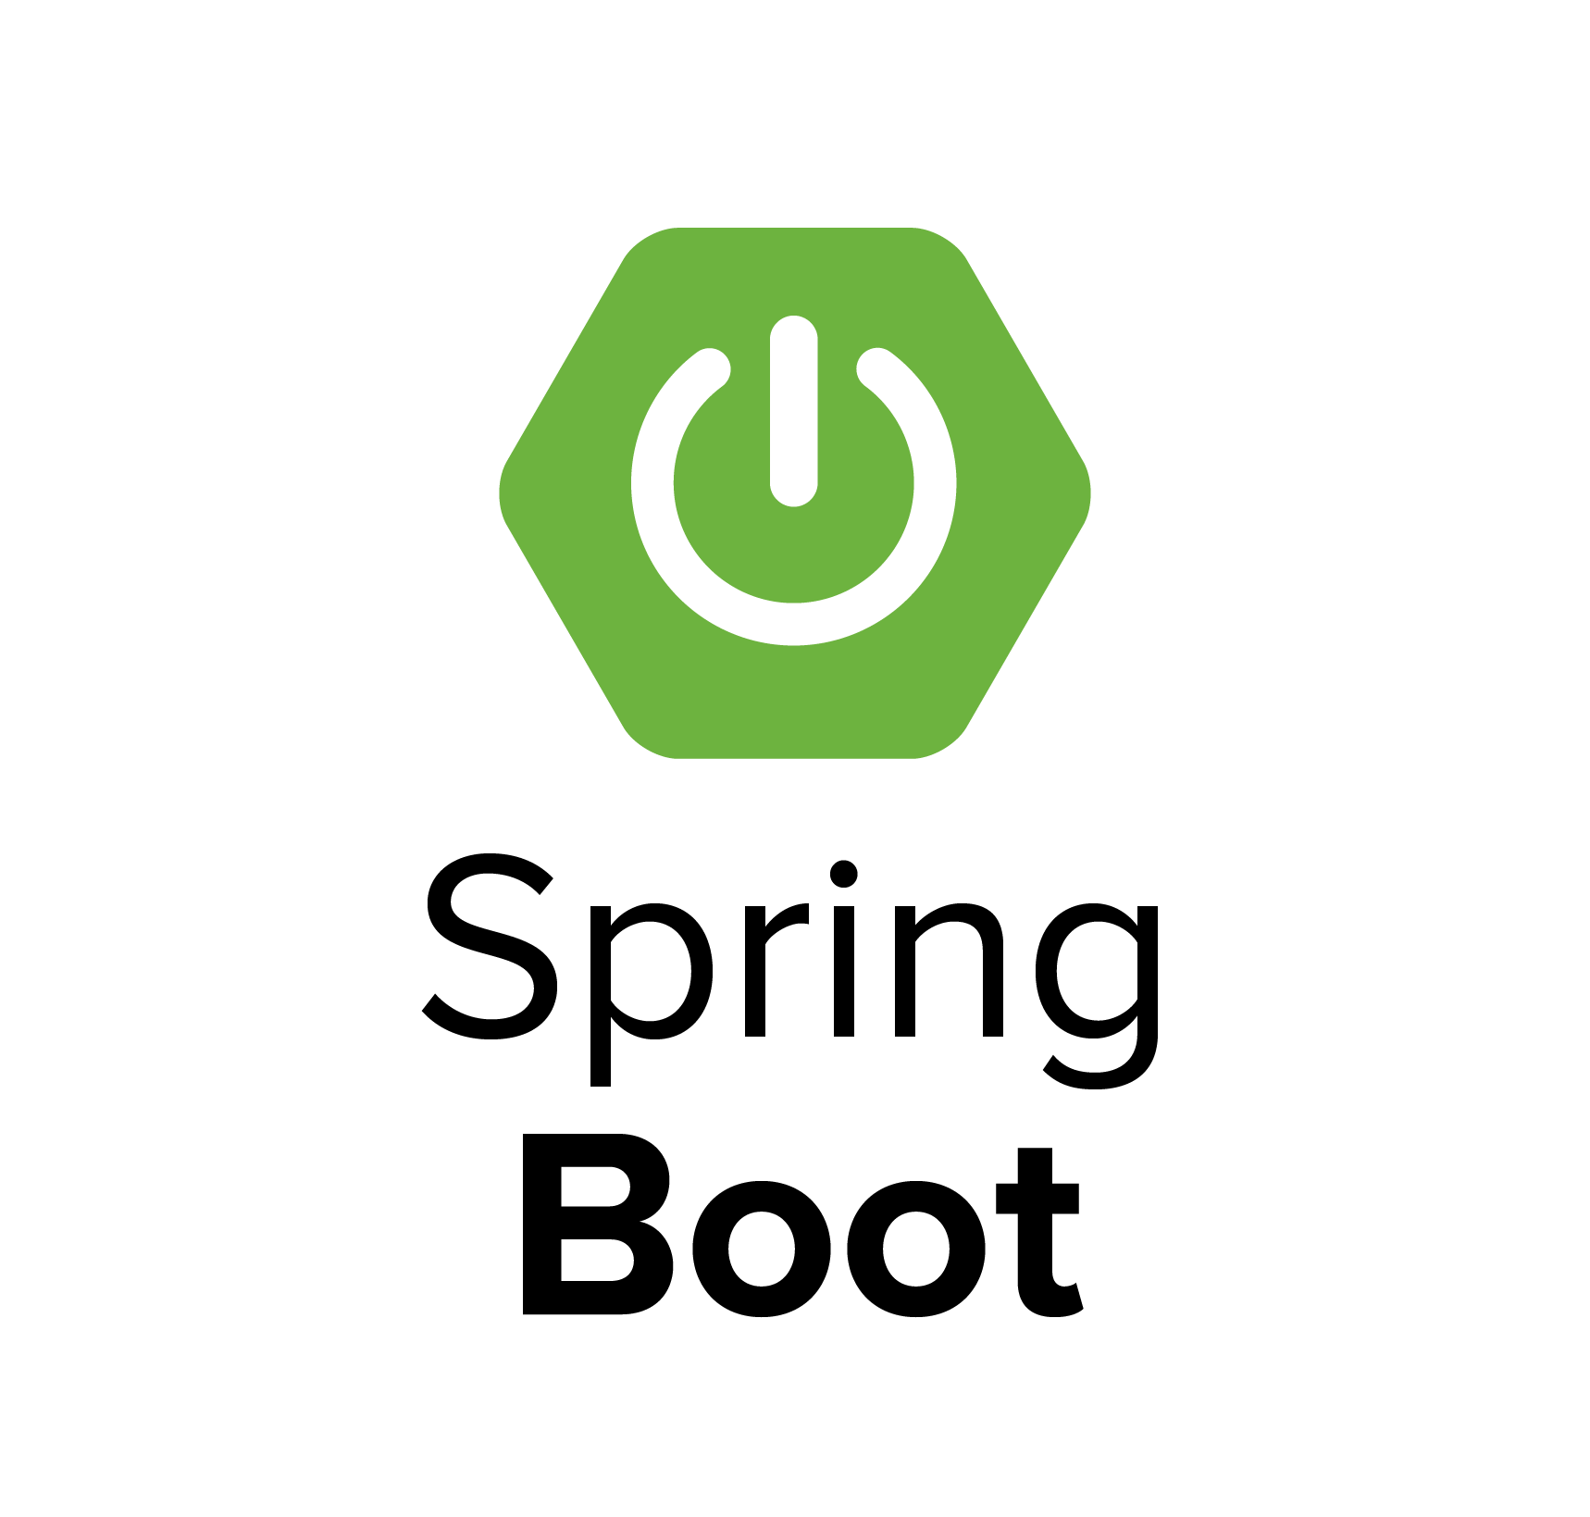

Knative
WHAT AN AMAZING WEEK!

Slide 3
LIES

Slide 4


Slide 5

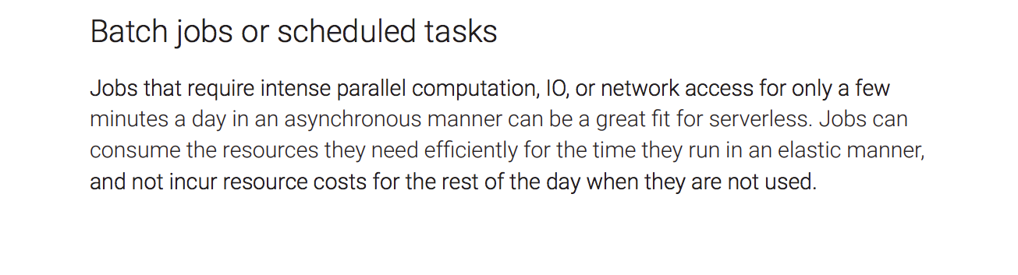
Notes:
Cloud Native Computing Foundation Serverless Whitepaper

Slide 6
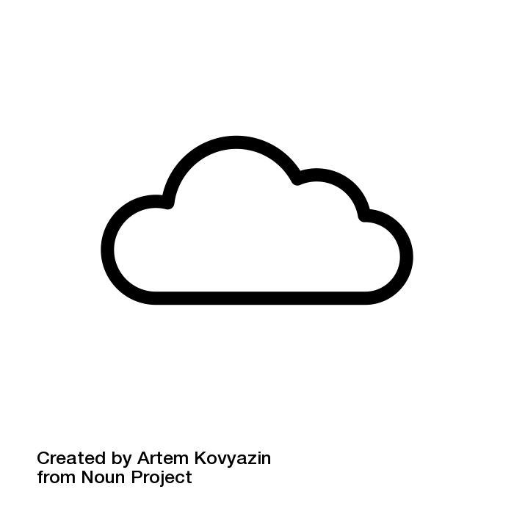

BATCH PROCESSING
FOLLOWS
AS WORKLOADS
MOVE TO THE CLOUD

Slide 7

COBOL

Slide 8
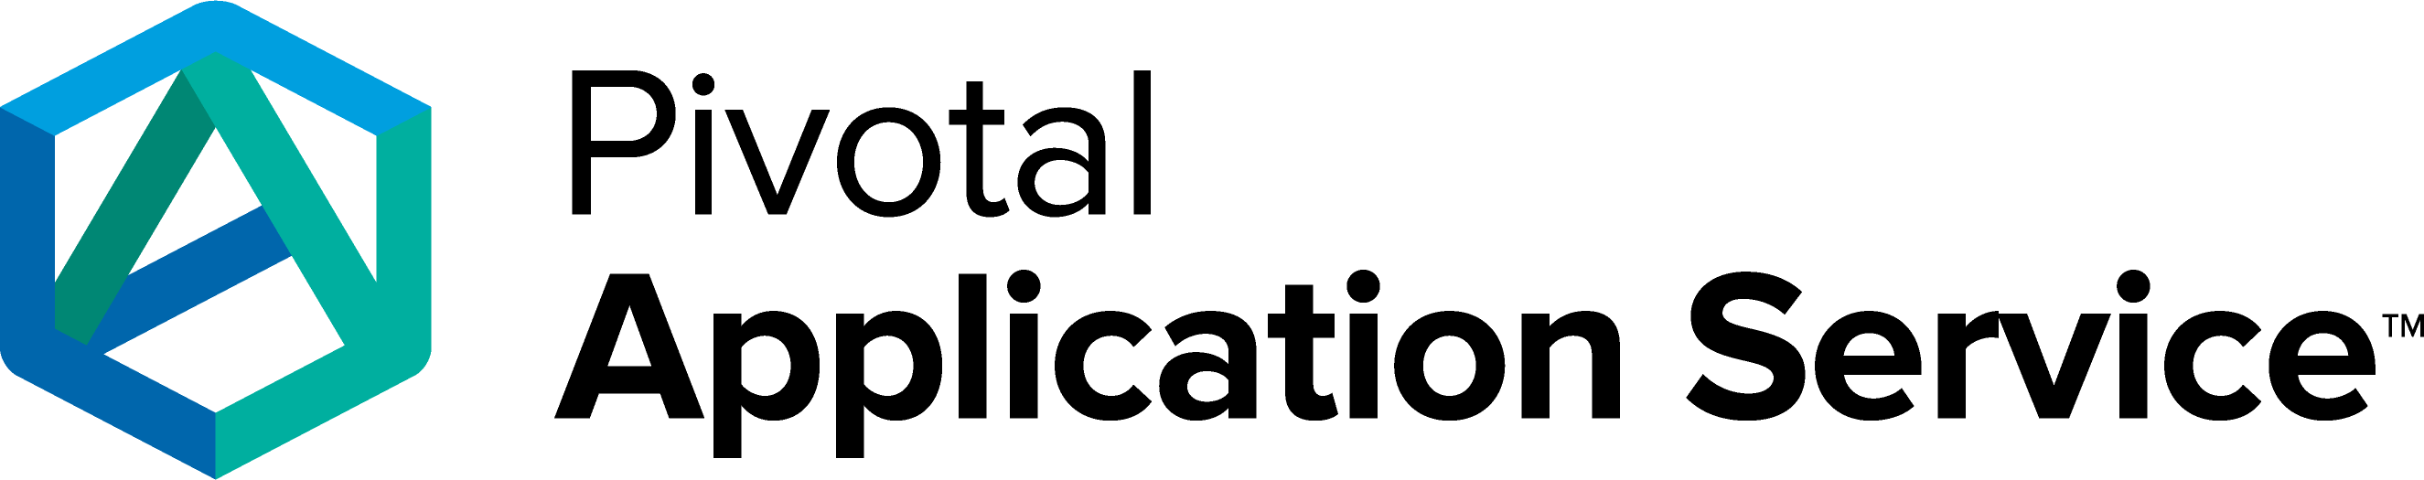
GREAT PLACES TO
RUN BATCH

Slide 9

WHY MOVE BATCH
TO THE CLOUD?

Slide 10

THE SAME REASONS
YOU ARE MOVING YOUR
OTHER WORKLOADS!

Slide 11
1
INCREASED
PRODUCTIVITY
Notes:
The agility of the cloud is not only for customer facing apps. They are for back end systems as well

Slide 12
2
ON DEMAND
SCALABILITY
Notes:
Extreme horizontal scalability on demand

Slide 13
3
IMPROVED
SECURITY
Notes:
Philip Young
https://www.evilmainframe.com/
6 years ago I started seeing talks on hacking and pentesting mainframes. Green screens != secure

Slide 14
4
REDUCED
COST
Notes:
Pay for what you use.
No dedicated cluster/hardware

Slide 15
WHAT DOES BATCH
LOOK LIKE IN THE CLOUD?
Notes:
Font found here: https://www.dafont.com/fff-tusj.font

Slide 16





Container
Spring Cloud Task
Spring Boot
Spring Batch
Notes:
We start off with Spring Batch. This provides the basic components for building batch applications
We add Spring Boot. You may actually start with Spring Boot if you’re starting with Josh Long’s second favorite place on the internet, start.spring.io. Boot simplifies the configuration and testing of your batch applications as well as adds additional non-functional features. None of this is new for Boot users…
On top of Spring Boot we add Spring Cloud Task. This framework is designed for building and running ephemeral microservices in a platform independent manor. It adds additional batch features including the ability to dynamically deploy workers for partitioned batch jobs giving you the cloud native elasticity everyone looks for as well as things like information messages available to be consumed downstream from a batch job.
All of the above components live in a jar…that is run in a container of some kind. On PAS, it’s taken care of for you by the platform. On PKS, you’d dockerize the application.

Slide 17

Spring Cloud Data Flow
Platform
Container
Container
Container
Spring Cloud Task
Spring Cloud Task
Spring Cloud Task
Spring Boot
Spring Boot
Spring Boot
Spring Batch
Spring Batch
Spring Batch

Slide 18
Task
Launcher
SFTP
Spring Cloud
Data Flow
Container
Container
Container
Spring Cloud Task
Spring Cloud Task
Spring Cloud Task
Spring Boot
Spring Boot
Spring Boot
Spring Batch
Spring Batch
Spring Batch

Slide 19
/** * @author Michael Minella */ @EnableBatchProcessing @Configuration public class BatchConfiguration { @Autowired private JobBuilderFactory jobBuilderFactory; @Autowired private StepBuilderFactory stepBuilderFactory; @Bean @StepScope public FixedWidthCobolItemReader<Store> reader(@Value("file:#{jobParameters['localFilePath']}") Resource inputFile, @Value("${job.copybook}") Resource copybook) throws Exception { FixedWidthCobolItemReader<Store> itemReader = new FixedWidthCobolItemReader<>(inputFile, copybook, line -> { Store store = new Store(); store.setStoreNumber(line.getFieldValue("STORE-NO").asInt()); store.setRegionNumber(line.getFieldValue("REGION-NO").asInt()); store.setStoreName(line.getFieldValue("STORE-NAME").asString()); store.setNewStore(line.getFieldValue("NEW-STORE").asString().equals("Y")); store.setActiveStore(line.getFieldValue("ACTIVE-STORE").asString().equals("Y")); store.setClosedStore(line.getFieldValue("CLOSED-STORE").asString().equals("Y")); store.setDcType(line.getFieldValue("DC-TYPE").asString());

Slide 20
